Slide 1
The Final Presentation

Slide 2

Manager of Contacts
Group 28
10/7/2019

Slide 3
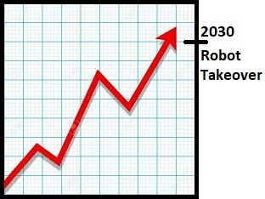

Contact Manager for Robots

Slide 4

Team Members
Vincent Barone
Front-End
Presentation
Junejae Kim
API
Database
Server Deployment
Ran Xu
API
Debugger
Andrew Nicely
Project Manager
API/Front-End

Slide 5
MERN Stack
MongoDB
Express.js
React
Node.js

Slide 6
Useful Resources
Discord
GitHub
Tachyons
AWS EC2 & Route 53

Slide 7
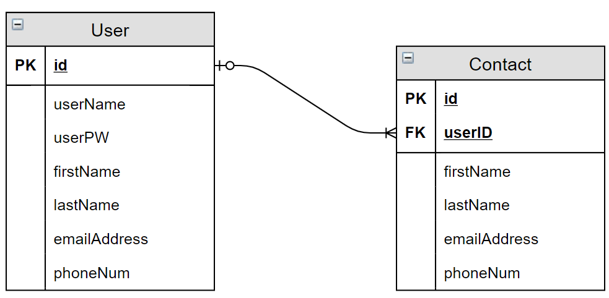
Entity Relationship

Slide 8
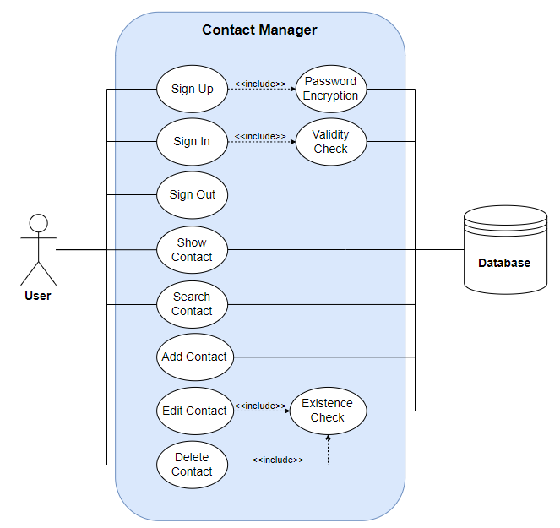
Use Case

Slide 9
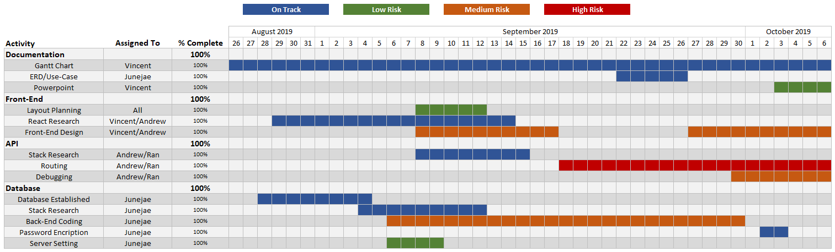
Gantt

Slide 10


What went well? What did not?
Weekly meet-ups
High knowledge absorption
Node Package Manager (npm)
Unable to connect to front-end
Front-end redesign required
React
Prior experience with MERN

Slide 11
Demonstration
http://www.allyourprojectarebelongtous.com/

Slide 12


Questions?

